Slide 1




NEXT GEN EMPLOYABILITY PROGRAM
Creating a future-ready workforce
Team Members
College Name
Student Name : S.Dhanushiya
Student ID : au951221104010
JP College Of Engineering

Slide 2

CAPSTONE PROJECT SHOWCASE
Project Title
Voting Web Application using Django Framework
Abstract | Problem Statement | Project Overview | Proposed Solution | Technology Used | Modelling & Results | Conclusion

Slide 3
Abstract
This project aims to develop a web-based voting application using Django, a high-level Python web framework. The application allows users to register, create, and participate in polls on various topics. It provides a user-friendly interface for voting, displaying real-time results, and managing polls. Security features such as authentication and authorization ensure the integrity and confidentiality of the voting process. The project leverages Django's built-in features for efficient development and scalability.
Source :

Slide 4
Problem Statement
Design and develop a web-based voting application using the Django framework. The application should allow users to register, log in, create polls, vote on existing polls, view poll results, and administer the application as an admin. Ensure security measures are implemented to prevent unauthorized access and tampering with the voting process. The application should provide a user-friendly interface and adhere to best practices in web development and user experience design.
Source :

Slide 5
Project Overview
Create a new Django app within the project to handle the voting functionality. This app will contain models, views, templates, and any other necessary components.Define Django models to represent the data associated with the voting system, such as User, Poll, Choice, and Vote.
Project setup
App creation
Database models
Admin interfaces
User authentication
Poll creation
Voting and results display
Frondend design and URL routing
Testing and deployment

Slide 6
Proposed Solution
.
Utilize Django's built-in authentication system for user registration, login, and logout functionalities.
Customize authentication views and templates as needed.
Implement views and templates for displaying candidates and allowing users to cast their votes.
Ensure that each user can only vote once and handle any potential errors or edge cases.
Register models with Django's admin interface to allow administrators to manage candidates, voters, and votes easily.
Customize admin views and templates for better usability if necessary.
Source :

Slide 7
Advantages
Rapid Development: Django's built-in features like ORM, admin interface, and authentication system accelerate development.
Scalability: Django's design patterns promote scalability, allowing the application to handle increased traffic and data volume.
Security: Django provides built-in protection against common security threats such as SQL injection, cross-site scripting (XSS), and cross-site request forgery (CSRF).
Modular Structure: Django's app-based architecture enables modular development, making it easy to add or modify features.
Community Support: Django has a large and active community, providing access to numerous libraries, plugins, and resources for assistance.
Source :

Slide 8
Disadvantages
Complexity: Django can be overkill for simple projects, adding unnecessary complexity.
Learning Curve: If you're not already familiar with Django, there will be a learning curve to understand its concepts and conventions.
Performance: Django might not be the best choice for high-performance real-time applications due to its synchronous nature
Scalability: While Django can scale, it may require additional effort compared to more lightweight frameworks for very large-scale applications.
Flexibility: Django's opinionated nature may limit flexibility in certain cases where you need to implement unconventional features or workflows.
Source :

Slide 9




Technology Used
Front-end
Back-end
Source :

Slide 10
Modelling & Results
In developing a voting application using Django, meticulous attention is directed towards both modeling the underlying data structure and effectively presenting the voting results to users.
Through Django's model system, the application's data architecture is meticulously crafted, typically featuring models like Question and Choice to represent the polls and available choices.
Once users have participated in the voting process, conveying the results to them becomes paramount.
Leveraging Django's templating system, the application dynamically generates HTML templates that vividly present the voting outcomes in an intuitive and visually engaging manner.
Furthermore, the application may utilize charting libraries or custom visualization techniques to elucidate the distribution of votes across different options, offering users valuable insights into the voting process's outcome.
Source :

Slide 11
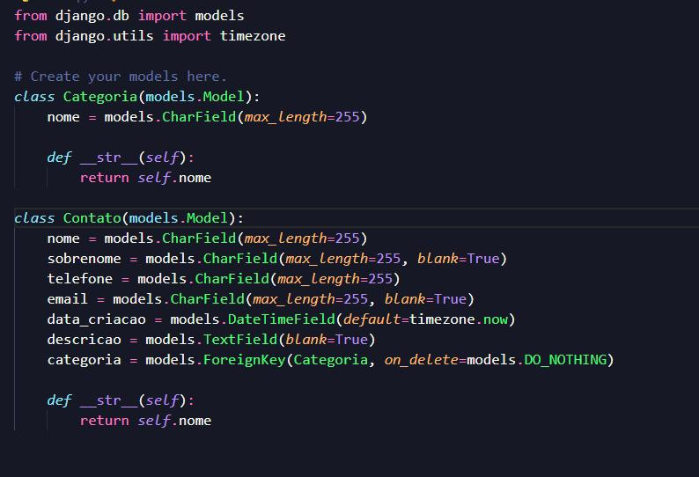
Homepage

Slide 12
About-Us-Page
1.Credibility: The "About Us" page establishes credibility by providing informationabout the organization's history, mission, and team members .
2.Mission and Values: It communicates the organization's mission, values, and objectivesin promoting democratic participation and decision-making.
3. Community Engagement: The page showcases the organization's commitment tocommunity engagement and empowerment through the voting process, inspiring active participation.
4. Contact Information: Users can easily reach out with questions, feedback, or inquiriesabout the voting application through the contact information provided on the page.

Slide 13
Service-Page
Header Section
Introduction section
User Services
Administrator Services
Organizational Services
Technical Services
Consulting Services
Call to Action Services

Slide 14
Departments-Page
Header Section
● Introduction Section
● Department Listings
● Department Details
● Key Personnel
● Collaboration Opportunities
● Footer Section

Slide 15
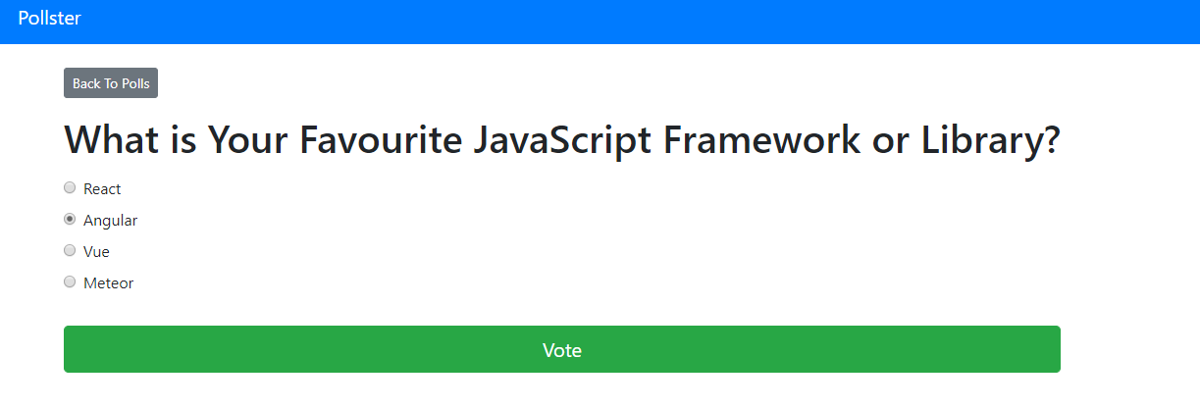
Blog-Page

Slide 16
Future Enhancements:
Utilize machine learning algorithms to analyze voting data, predict future trends, and provide personalized recommendations for users based on their voting history and preferences
Extend the voting application's reach by developing native mobile apps for iOS and Android platforms, offering a seamless and optimized experience for mobile users.
Explore integrating blockchain technology to enhance the transparency, security, and integrity of the voting process, ensuring that votes are immutable and tamper-proof.
Implement comprehensive reporting functionalities for administrators to generate detailed reports on voting patterns, demographics, and trends. This could include visualizations such as charts and graphs.

Slide 17
Conclusion
 | In concluding your voting application project using the Django framework, you could summarize key achievements, challenges faced, lessons learned, and future improvements or extensions. Additionally, you might reflect on the project's impact, relevance, and potential for further development or real-world application. It's also helpful to mention any insights gained into Django development practices and the overall experience of working on the project.
Source :

Slide 18
Thank You!
Notes:
Thank You !!

